Slide 1
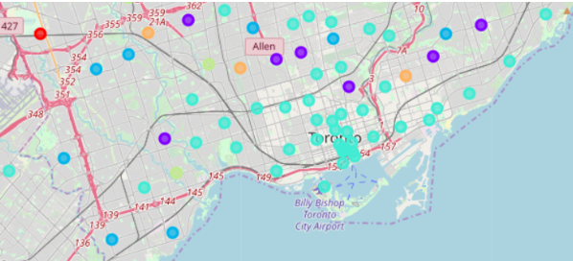
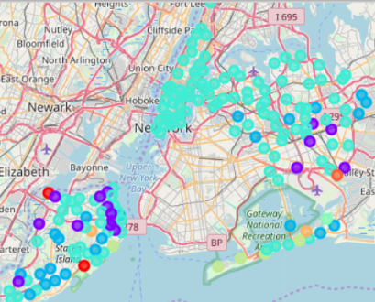
Where Should I Move?
A moving guidance app based on foursquare and clustering in python

Slide 2
Case study: Toronto to Queens/Staten Island
This report uses a hypothetical move
The hypothetical person is moving from Manhattan, having previously lived in Toronto
The hypothetical person is considering moving to Staten Island or Queens
The goal is to give the user a “from-to” table where the “from” is neighborhoods in Toronto or Manhattan, and the “to” is neighborhoods that are similar in Queens or Staten Island.

Slide 3
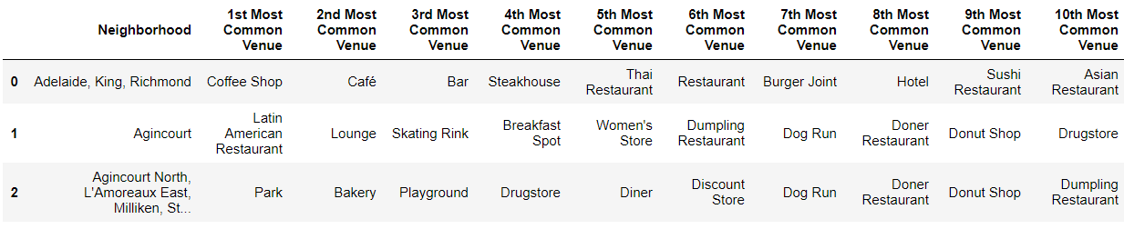
Data Acquisition and Cleaning
Two parts: acquiring neighborhood/postal code data and associating venues
Neighborhood/postal code data was scraped from Wikipedia articles. Then, each neighborhood was associated with an address using geocoder algorithms
Once address were obtained, Foursquare was used to find 100 venues for each address
Tables for each location (Toronto, Manhattan, Staten Island and Queens) were generated with the top 10 venue for each neighborhood
Finally, a macro table was create with all location neighborhoods considered simultaneously (as if they were one location)

Slide 4
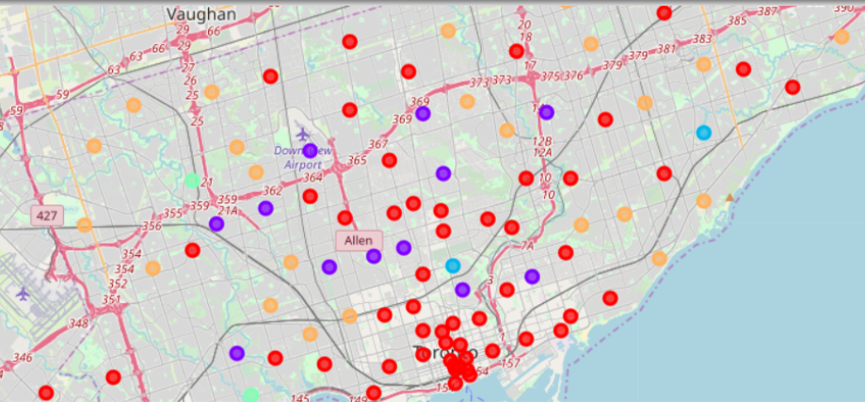
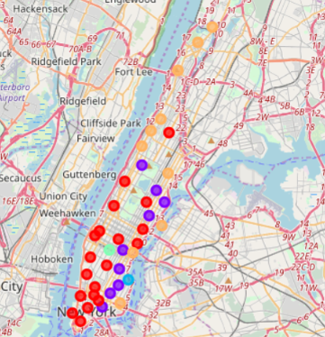
Describing each location: Toronto and Manhattan
Clustered Toronto Neighborhoods
KMeans with 5 clusters
Toronto cluster radiate from city center
Manhattan dominated by quadrants
5 clusters seems sufficient
Clustered Manhattan Neighborhoods

Slide 5
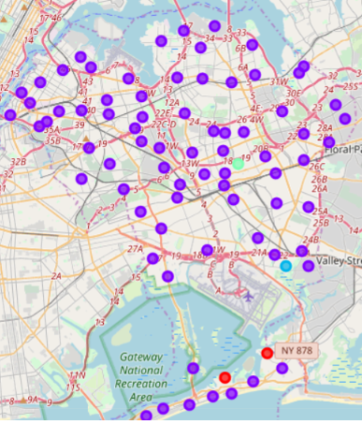
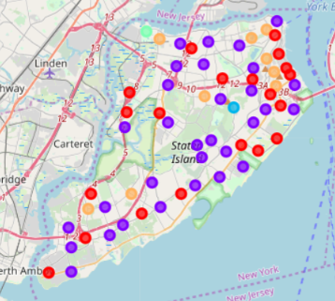
Describing each location: Queens and Staten Island
Clustered Queens Neighborhoods
KMeans with 5 clusters
Queens is dominated with one cluster, with a few unique neighborhoods
Staten Island has a large coastal cluster, a large internal cluster, and a few outlier neighborhoods
5 clusters seems sufficient
Clustered Staten Island Neighborhoods

Slide 6
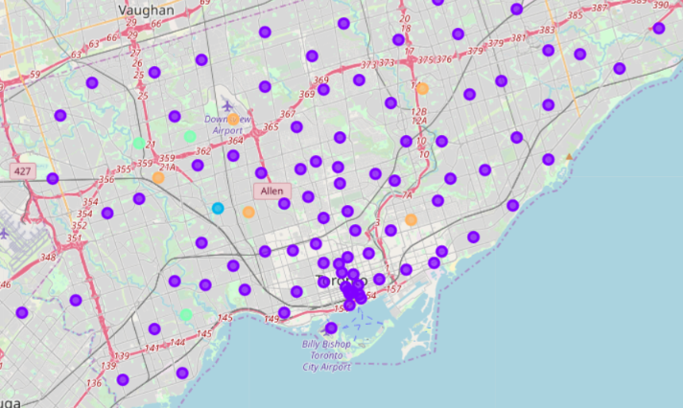
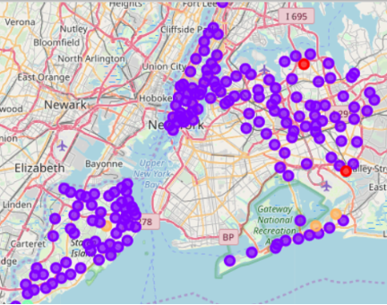
Macro Dataset: parameter refinement
Clustering the enter data set with 5 clusters is very sparse
Clustering with 9 clusters reveals distinct regions that are consistent with the individually clustered on the previous slides.
Toronto region, 5 clusters
New York region, 5 clusters
Toronto region, 9 clusters
New York region, 9 clusters

Slide 7
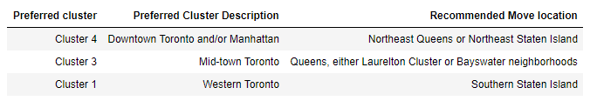
Final recommendation
3 clusters are most useful (represented in “from” as well as “to” locations
The table below summarizes the movement guidance for this hypothetical example

Slide 8
Conclusion and future directions
Hypothetical case successful: clear guidance for moving location was generated using the neighborhood/foursquare/clustering approach
Case study is scalable, as data acquisition, cleaning and clustering can be automated for arbitrary “to” “from” locations
Future work may include a human readable description of clusters. I had to manual describe the clusters in this report, but using compos directions and map hints may automate this process.
Thanks!

